Slide 1

Sprint 3

Slide 2
User Stories
As a User I need to be able to sign in so I can upload videos for my friends to watch.
Acceptance Criteria: User is able to create an account and upload a video.

Slide 3
User Stories
As a User I need to be able to see what videos I have upload so that I don’t upload the same video more than once.
Acceptance Criteria: Created a new user profile page which shows all videos a user has uploaded.

Slide 4
Sprint Goals
Give
Give users the ability to create accounts and upload videos
Allow
Allow users to quickly see a history of all the videos they have uploaded
Allow
Allow current users to sign in and out of Media Monkey
Update
Update the front page to increase user experience and usability.

Slide 5
Issues We’ve Encounter and How We Fix it
Making sure website was usable in debug mode.
Combining the user and profile files
Logging in with A2 hosting

Slide 6
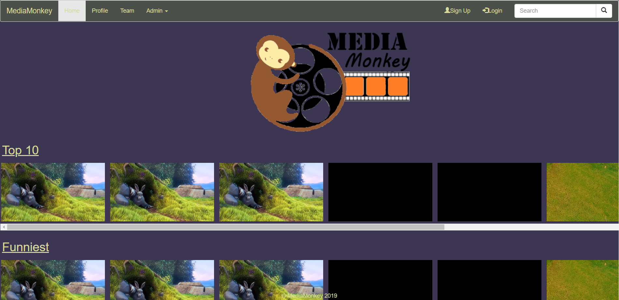
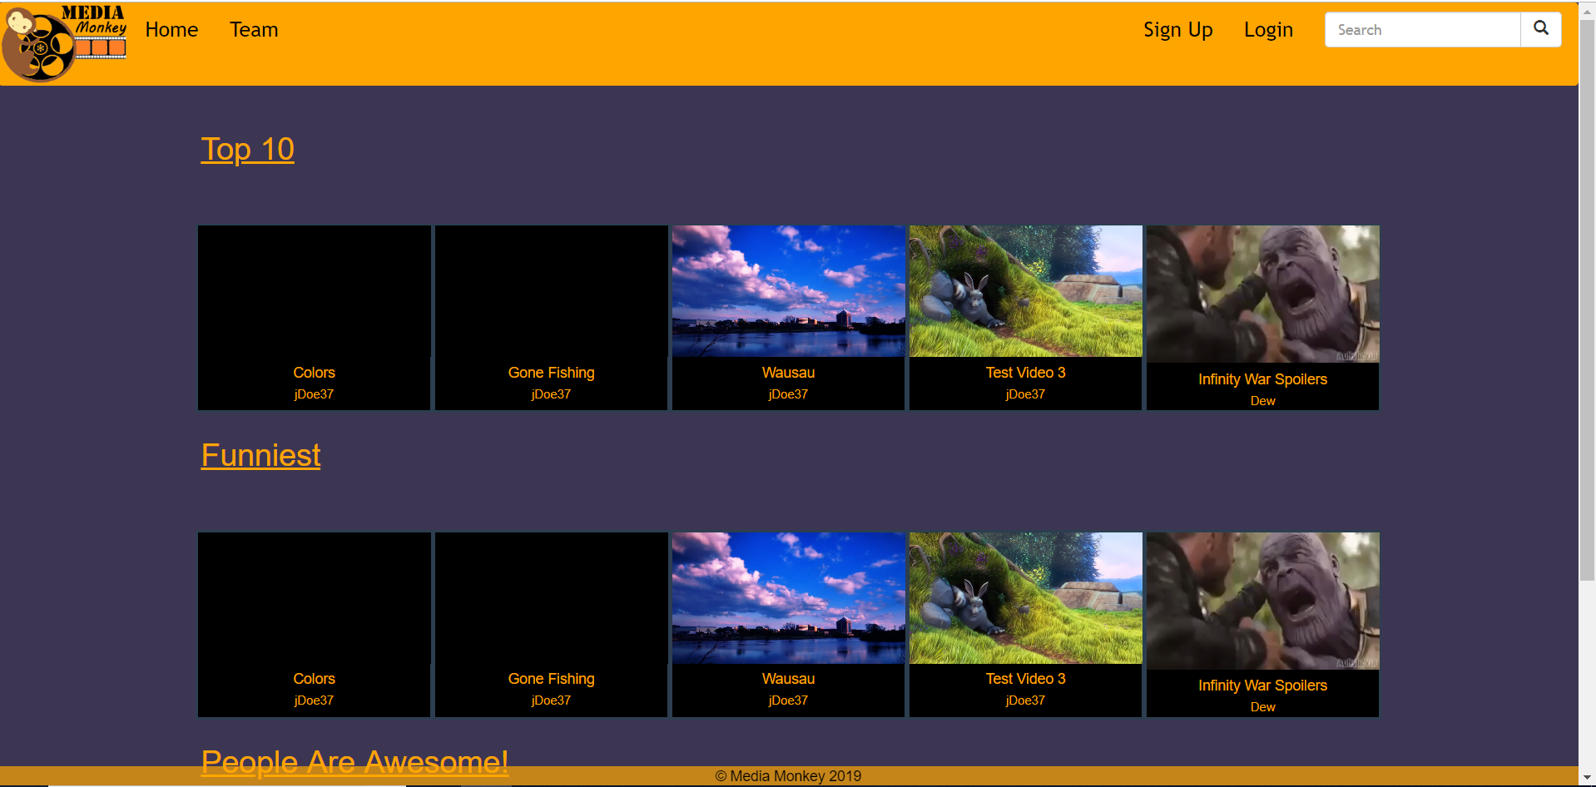
Sprint 2 vs Sprint 3

Slide 7
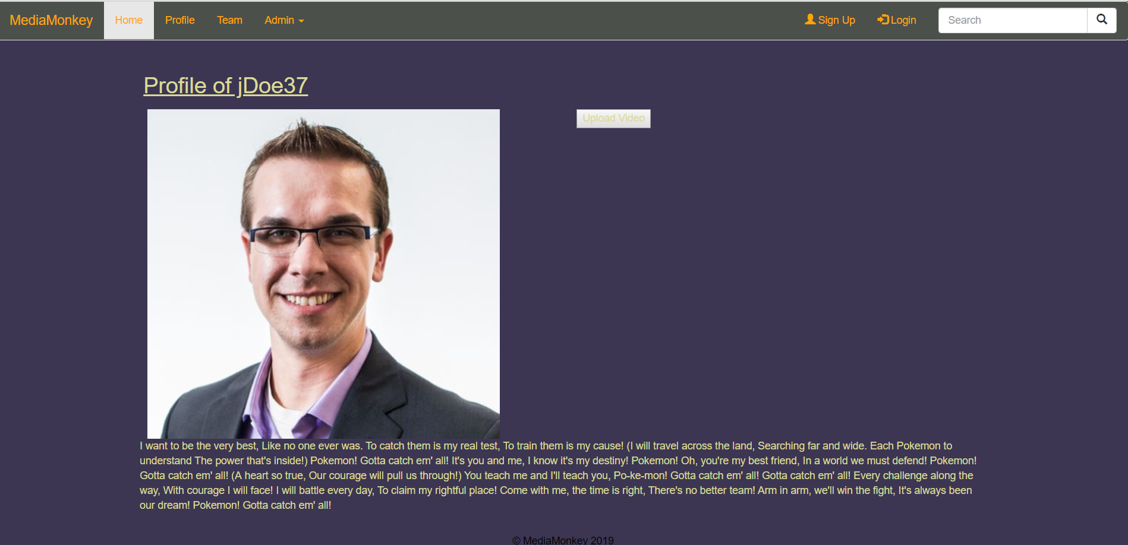
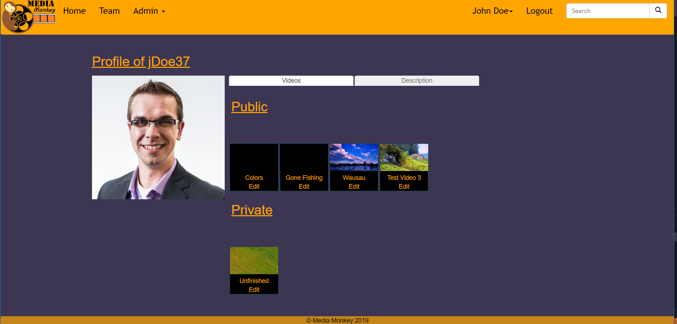
Sprint 2 vs Sprint 3

Slide 8
User Story for Sprint 4
As a user I need to be able to like and dislike videos plus comment on videos so that I can let other users know how I feel about it.
As a product owner I need to be able to assign different roles to my users so that daily users are not given admin controls.

Slide 9
Demo Time:

